Slide 1
Workers Compensation Insurance

Slide 2

Agenda
Workers Compensation and Employers Liability Introduction
WC Concepts
State Modifications
General Provisions of WC Law
Workers’ Compensation benefits
Assigned Risk vs. Voluntary Compensation Insurance
Rate establishment & NCCI
State wise Bureau List

Slide 3

Workers Compensation and Employers’ Liability Introduction
Workers Compensation and Employers’ Liability Insurance:
Workers Compensation and EL Insurance responds to two basic loss exposure faced by employer:
1. The legal responsibility to pay benefits to employees as required by state workers compensation statutes.
2. The cost to defend against and possibly pay, liability claims made against the employer on account of bodily injury to an employee.

Slide 4
Workers Compensation and Employers’ Liability Introduction (Cont….)
Requirement of Benefits:
Provides Benefits for Medical Expenses from either occupational injury/disease.
Cause of Injury/Disease must be related to employment & in course of employment.
There must be A CAUSE & EFFECT RELATION between the OCCUPATION & DISEASE
Provides benefits for wage loss from either occupational injury/disease.

Slide 5
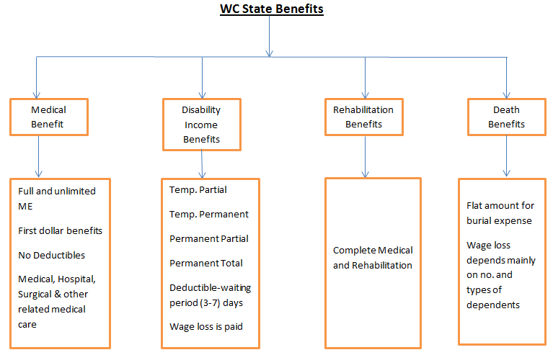
Workers Compensation and Employers’ Liability Introduction (Cont….)

Slide 6
Workers Compensation Exclusions
Workers Compensation Exclusions:
Damages for injury or death for any illegally employed person.
Bodily injury intentionally caused by the insured.
Damages arising out of employment practices, including demotion, harassment, discrimination, and termination.
Fines or penalties imposed for violation of federal or state law.

Slide 7
What is 'Employer's Liability Insurance'
An insurance policy that provides coverage for an employer's two key exposures arising out of injuries sustained by employees. Part One of the policy covers the employer's statutory liabilities under workers compensation laws, and Part Two of the policy covers liability arising out of employees' work-related injuries that do not fall under the workers compensation statute. In most states, the standard workers compensation and employers liability policy published by the National Council on Compensation Insurance (NCCI) is the required policy form.
Employer's liability insurance can be packaged with workers compensation insurance to further protect companies against the costs associated with workplace injuries, illnesses and deaths that aren’t covered under workers compensation. Employer's liability insurance is also called “part 2” of a workers’ compensation policy.
This coverage provided by part 2 of the workers compensation policy provides coverage to the insured (employer) for liability to employees for work-related bodily injury or disease, other than liability imposed on the insured by a workers compensation law.
Notes:
A product for employers that protects them from major financial loss if a worker experiences a job-related injury or illness that workers compensation doesn’t cover

Slide 8
Employers Liability
Employers Liability :
The insurer agrees to defend the insured against claims and suits seeking covered damages. There are ways in which the employer can be held liable under the common law as the result of employee injury:
An employee of the insured sues a third party (such as machine manufacturer) for an occupational injury, and the third party then sues the employer. The third party’s suit might allege, for example, that the employer was negligent in maintaining the machine.
The spouse or family member of an injured employee sues the employer for loss of companionship or services (such as housekeeping or yard work that the employee would otherwise have performed) resulting from the injury.

Slide 9
Voluntary Compensation
Voluntary Compensation :
The WC laws of most states exempt some types of employment from statutory WC benefits. The most commonly exempted occupations are farm labor, domestic employment, and casual labor. In some cases, the law does not apply to employers with fewer then a certain minimum no. of employees. The WC laws of some of the state do not apply to partners and executive officers.

Slide 11
Anniversary Rating Date
Anniversary Rating Date:
The basic purpose of the anniversary rating date is to prevent a workers compensation insured, policyholder, or insurance company from cancelling the workers comp policy midterm, before the normal expiration date, to take advantage of lower rates that may now be in effect that were not available when the policy was originally written.
For Entered Classes, Catastrophe and Terrorism Modifiers below rule is applied:
When the difference between the ARD date and Policy effective date is more then 90 days,
policy is called absolute ARD policy
If the state is an ARD state, rate applicable as on ARD will be applies for split-1 and ARD+12 for split-2.
If the state is a Non-ARD state rate applicable as on policy effective date applies to both the splits

Slide 12
Anniversary Rating Date (Cont…)
When the difference between the ARD date and Policy effective date is less then 90 days, policy is called 3 months ARD policy
If the state is an ARD/non-ARD state, rates applicable on policy effective date applies for the whole policy period. There is no split in the policy.
For Other Modifiers:
Apply the rate and stat based on policy effective date for the whole period irrespective of the fact that the policy has ARD or not and the state follows ARD or not.

Slide 13
Classification
Classification (Class Codes):
Classification is represented by a four digit number and groups businesses together that share common exposures to hazards.
For example,
Dairy Farms are grouped together using Code 0036 – Farm: Dairy
Plumbers are grouped together using Code 5183 – Plumbing NOC
Note: The rate is different for these two classes as the exposure to workplace injury is different.
In establishing a classification, the following criteria is considered:
There must be a large enough group of employers so that a statistically credible rate can be produced.
The businesses must be readily identifiable.

Slide 14
Premium Calculation
Premium Calculation
Premium is calculated by assigning a business classification code (or combination of codes) that best describes the business operations. Each code represents a rate per $100 of payroll that is multiplied by the total estimated annual payroll for that code. Other factors may affect the calculation, such as business's safety practices, past history and experience modification.

Slide 15
Payroll Audit
Payroll
Payroll refers to the amount paid to employees by the business for services they provide during a certain period of time.
Audit
Insurance company’s examination of an insured business’s payroll records in order to determine the final premium due on a workers’ compensation insurance policy.
A premium audit is conducted on Workers' Compensation policy. The primary function of the audit process is to determine the actual payroll used in calculating the final premium on the policy. The premium will be adjusted as a result of the audit. If payroll have been underestimated, this will result in additional billing & if payroll have been overestimated, a billing credit will result.
That is why while issuing a policy premium is always estimated premium which is audited later on to get the final premium.

Slide 16
Payroll Audit (Cont…)
Audit frequencies assigned for Workers’ Compensation policies are:
Annual
Monthly
Quarterly
Semi-annual
Monthly, Quarterly & Semi-annual audits are also called “Interim Audit” where as Annual audit is also called “Final” audit.

Slide 17
Payroll Audit (Cont…)
Audit Functions:
At the time of performing audit on the Workers Compensation policy, an auditor has the option to perform the following functions on the policy:-
Update Payroll:- Under this the auditor updates the payroll recorded on the policy and the premium is adjusted according to the same. If payroll have been underestimated, this will result in additional billing & if payroll have been overestimated, a billing credit will result.
Accepting Estimates:- Under this the auditor user the previously entered payroll estimates as the basis of the final audit recalculation. In this case here is no premium change.
Waive Audit :- Under this the auditor can waive off the audit for a particular policy. It may happen in cases which involve a small premium amount. In order to save the audit cost, it can be waived off
Update Premium:- Under this the auditor updates the premium recorded on the policy and the payroll is not adjusted.

Slide 18
Workers Compensation Algorithm
While calculating the premium of a policy, Algorithm for that particular state has always been taken care of.
Premium Algorithm comprises of 4 different components which are in subtle order and cumulatively arrive at the Estimated Annual premium.
4 Components of Premium computation flowchart:
Manual Premium
Subject Premium
Modified Premium
Standard Premium
& these adds up to
Estimated Annual Premium

Slide 19
GA State Algorithm
Essentials for these premium:
PREMIUM ELEMENTS | EXPLANATORY NOTES
MANUAL PREMIUM | [(PAYROLL / 100) * RATE]
Supplementary Disease (foundry, abrasive, sandblasting) | [(SUBJECT PAYROLL / 100) * DISEASE RATE]
USL&H Exposure for non-F classification codes | [(SUBJECT PAYROLL / 100) * (RATE * USL&H FACTOR)]
TOTAL MANUAL PREMIUM

Slide 20
GA State Algorithm (Cont…)
Waiver of Subrogation | [% applied to the portion of Total manual Premium where waiver is applied]
Employers Liability (E/L) increased limits factor | [% applied to Total Manual Premium]
Employers Liability increased limits charge | [Balance to E/L increased limits minimum premium]
Employers Liability increased limits factor (Admiralty, FELA) | [Factor applied to the portion of Manual Premium where Admiralty/FELA coverage is applicable]
Employers Liability/Voluntary Compensation flat charge | [Coverage in Monopolistic State Funds]
Small Deductible Credit | [% applied to Total Manual Premium]
TOTAL SUBJECT PREMIUM
Experience Modification (Exp Mod)
TOTAL MODIFIED PREMIUM
Georgia Schedule Rating Factor (1-SR Credit%) or (1-SR Debit%)
Managed Care factor (1-M/C Credit%)
Drug-Free Workplace factor (1-DFW Credit%)
Supplemental Disease Exposure (Asbestos, NOC)
Atomic Energy radiation Exposure NOC
Aircraft Seat Surcharge
Balance to Minimum Premium | [Balance to minimum premium at Standard Limits]
TOTAL STANDARD PREMIUM

Slide 21
GA State Algorithm (Cont…)
Premium Discount[§] | [% applied to Standard Premium]
Coal Mine Disease Charge
Expense Constant
Terrorism | [(PAYROLL / 100) * TERRORISM VALUE]
Catastrophe (other than Certified Acts of Terrorism) | [(PAYROLL / 100) *CATASTROPHE (OTHER THAN CERTIFIED ACTS OF TERRORISM) VALUE]
ESTIMATED ANNUAL PREMIUM
TOTAL AMOUNT DUE
Personal
Lines

Slide 22
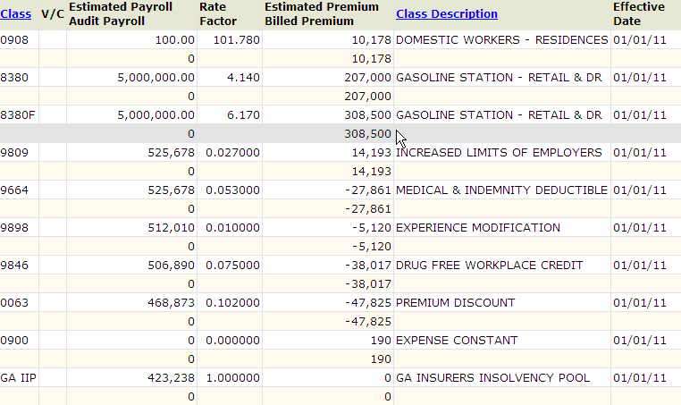
WC Exclusions
Personal
Lines

Slide 23
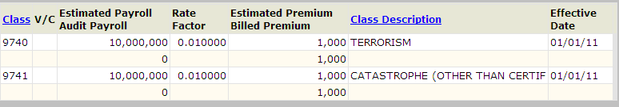
WC Exclusions
Personal
Lines

Slide 24
Deductible
Deductible:
An Insurance Deductible is the amount, the insured is required and obligated to pay by the insurance policy. The deductible is chosen by the insured and is usually applied to coverage's. Generally the lower the deductible, the higher the insurance premium.
Small Deductible:
A form of workers compensation insurance introduced in 1990 and approved for use in some states. The employer pays a reduced premium but must reimburse the insurer for claims that fall within the deductible amount.
Small deductible plans were developed for those employers who are not eligible for more complex premium savings programs or who may not be of the size to qualify for those other plans. These plans were also developed with the idea in mind to provide incentives for employers to implement loss control programs that ultimately assist in reducing the employers cost for workers compensation insurance. Small deductible plans vary from state to state with many approved deductibles ranging from $500 to $5,000.

Slide 25
Deductible (Cont…)
Large Deductible:
Large deductible policies are designed to give employers that are willing to retain most of the risk an option that reduces their insurance costs without depriving employees of the certainty of insured benefits. When large deductible policies operate as intended, they provide the best of both worlds. The employer gets cost savings from quasi-self-insurance, while its employees remain fully insured.

Slide 26
USL&H Coverage
USL&H refers to the United States Longshore and Harborworkers' Compensation Act. This is a federal workers' compensation law enacted to provide benefits for employees in the event of their injury or death when working on or near navigable waters of the U.S. and engaged in maritime employment. The Act excludes certain employment such as masters and crew members of vessels.
The USL&H compensation act follows the same principles as the state WC act. In some circumstances, an employer may be subject to both the USL&H and the state WC law at the same time. Although both of these exposures may be insured, they must be covered and rated separately.
Coverage can be provided by adding the USL&H worker’s compensation act endt. to the WC&EL policy. The endorsement amends the definition of ‘workers compensation law’ to include the USL&H with respect to operations in any state designated in the endorsement schedule. (In practice, many WC&EL insurers are unwilling to add LHWCA coverage because of the unfavorable loss experience associated with the LHWCA.)
For example:
Payroll Classification: 8810 : Clerical Employees NOC
USL&H Classification: 8810F: Clerical Employees NOC – USL&H

Slide 27
Experience Rating
Introduction to Experience Rating
Experience Rating uses the employer’s past experience” (losses) to project future losses.
Why have Experience Rating?
Incorporates both debits and credits
Gives employers some influence on their final premium
Provides incentives for safety programs
Promotes occupational health and safety
The experience of the employer is usually derived from the latest available three years. The experience is then compared with the “average” of all employers in that classification.
Experience ratings are not made by the insurance carriers. The experience ratings are computed by the appropriate advisory organization, such as the National Council on Compensation Insurance, Inc. (NCCI). The employer qualifies for experience rating if the manual premium exceeds an eligibility point. (Eligibility criteria differ by state.)

Slide 28
Experience Rating (Cont …)
Equal to the average = UNITY (a Unity mod equals 1.00)
Lower than average = CREDIT (a Credit mod is less than 1.00, such as 0.75)
Higher than average = DEBIT (a Debit mod is greater than 1.00, such as 1.10

Slide 29
Premium Discount
Premium Discount:
Many of the expenses of providing workers compensation do not increase proportionately with increase of premium. For example, the cost of policy issuance and premium collection generally do not increase with the size of the premium. Underwriting expenses does increase with the size of premium, but it generally do not increase 100 times as much to underwrite a policy with a $100,000 premium as it does one with a $1,000 premium. Furthermore, the percentage paid to producers as commission is usually reduced as the premium increases. In recognition of these lower expenses, the premium discount plan provides an increasing credit for premiums.

Slide 30
Expense Constant
Expense Constant:
An expense constant is a flat charge designed to cover the administrative expenses, such as policy issuance and record keeping, that are common to all the policies. An expense is applied regardless of the size of the policy premium. Not every state calls for an expense constant charge.

Slide 31
Minimum Premium
Minimum Premium Concepts:
This is the minimum amount that needs to be charged for a particular coverage (class code).
This is generally charged under generated class code 'To equal Min Premium'.
The class codes with ZERO payroll are referred to as 'if-any' classes.
The concept of Min Premium will only come into picture when the total subject premium is less then the minimum premium associated with the class code.
When the min premium of a class code is less then the expense constant then the total estimated premium for the policy is equal to the expense constant.
When the min premium of a class code is greater then the expense constant then the total estimated premium for the policy is equal to the 'EC'+'To equal Min Prem' or minimum premium associated with the class code.

Slide 32
Minimum Premium (Cont…)
For the policies having multiple class codes, the highest minimum premium associated with the class code will be considered as the min prem.
Min Prem Calc Formula for Payroll classes: [(LC*LCM)*DM] + EC
Min Prem Calc Formula for Non-Payroll classes: [(LC*LCM)*1] + EC

Slide 33
Schedule Rating
Schedule Rating:
Schedule rating may be used in addition to experience rating. The NCCI or other appropriate rating bureaus administer the Schedule rating plans.
Schedule rating credits or debits are applied after the Experience modification. The maximum credit or debit is 25 percent. The goal of schedule rating is to reflect characteristics of a particular company that are not reflected in experience rating. NCCI rules require that schedule rating be applied to filed and approved rates without deviations. Deviations are discounts that are filed by carriers and applied to rates before the premium is calculated.
Why Is This Important?
The rates that are used for workers compensation coverage often are fairly consistent across classifications. However, businesses can directly control their premiums by preventing and managing claims to earn a lower experience mod. In addition, they can institute safety and employee training programs that enable them to qualify for schedule rating, another source of potentially lower premiums.
The opposite also is true. Both experience and schedule rating penalize businesses that fail to institute programs to prevent and manage claims. These businesses are forced to pay higher premiums for coverage that is mandated by law.

Slide 34
Schedule Rating (Cont…)
Schedule Rating:
Schedule credits or debits are assigned for reasons such as:
Drug free workplaces
Management cooperation
Safety devices and equipment
Safe work environments
Active employee safety committees
On-premises emergency medical facilities or personnel
Selection, training, experience, controls motivation, and supervision of employees
Classification peculiarities caused by technology, employee distribution, or assignment.

Slide 35
Retrospective Rating
Retrospective Rating:
The Retrospective Rating Plan bases the employer’s premium on its size and actual experience for the policy period, subject to maximum and minimum limits.
An initial premium is charged and then adjusted at the end of the policy period to reflect the actual losses.
A premium discount does not apply to policies written under a retrospective rating plan at the inception.

Slide 36
Deductibles
Deductibles:
In almost all non-monopolistic states, an insured can reduce its premium by electing a deductible plan. The deductible applies to both medical and lost-time claims on a per claim basis. For example, about 1 percent of premium for a $100 deductible, and 3 to 6 percent for a $500 deductible.
Large Deductible Plan, those with deductibles in the $50,000 to $250,000 per claim range, greatly reduce the premium and are available in most of the states. Insured electing such a plan are, in effect, self insuring most of their workers compensation exposure since most claims are less then deductible.
NB 1. The only impact of deductibles on the policy is that it will reduce the premium.
NB2. The LD and PD is mutually exclusive in most of the states.

Slide 37
Rate Deviation
Rate Deviation:
In some states, insurer are permitted to apply a rate deviation factor (for example, 10 percent) to the premium as calculated by the rating manual. Insurers generally reserves these credits for better risks, although competitive pressures sometime result in average risk receiving a deviated premium.

Slide 38
Assigned Risk vs. Voluntary Compensation
Businesses who have had unsatisfactory loss performance or whose employees perform such hazardous functions that voluntary insurance companies will not insure them, can be assigned to an insurer.
The Assigned Risk Plan provides a policyholder and their employees with the Statutorily mandated medical benefits and compensation for lost wages due to injury, occupational disease, or death arising from their employment.
The rates charged in the Assigned Risk Plan are often higher than what is available in the voluntary market.

Slide 39
Rate Establishment & NCCI
Rate Establishment
Most states require an insurer to belong to a single approved rating organization in order to write WC Insurance in a specific state.
Rating data is filed either through an independent state bureau or via a large rating/ statistical information gathering organization, such as NCCI
The National Council on Compensation Insurance (NCCI)
The National Council on Compensation Insurance (NCCI) is a U.S. insurance rating and data collection bureau specializing in workers' compensation. Operating with a not-for-profit philosophy and owned by its member insurers, NCCI annually collects data covering more than four million workers compensation claims and two million policies.

Slide 40
Rate Establishment & NCCI (Cont…)
Servers as the filing agency for insured in most states.
Prepares standard form and endorsements.
Many independent rating bureaus use NCCI for their data.
Even in states that don’t utilize any NCCI service, most procedures generating resemble those of NCCI.

Slide 41
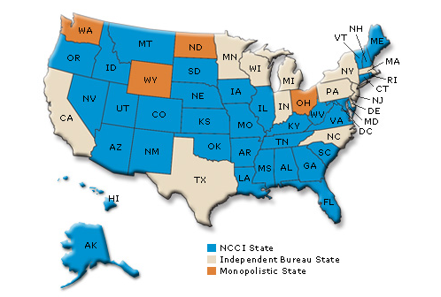
State Wise Bureau List
NCCI States – Rating and data collection is done by the NCCI.
Independent Bureau State- Rating and data collection is done by the Private state bureaus.
Monopolistic State- Only state fund can provide the insurance. Private insurers are not allowed to operate in the states.

Slide 42


Thank You
EXPERIENCE
EXPERTISE
R&D
APPROACH (KEEP-CUSTOMER-FOR-LIFE approach)

